Slide 1
Session 3
Control flow statements contd..
While, do while, switch, example

Slide 2
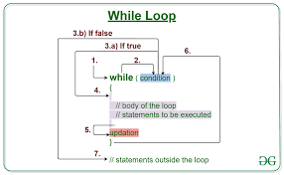
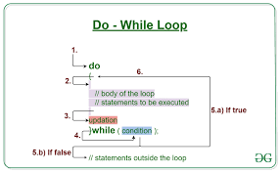
Control flow statements contd..
While Loop, DoWhile Loop, and Switch Statement.
These constructs allow us to control the flow of execution in our Java programs based on certain conditions and make our code more efficient
While Loop:The while loop repeatedly executes a block of code as long as a specified condition is true.
DoWhile Loop:The dowhile loop is similar to the while loop, but it guarantees that the code inside the loop will be executed at least once, even if the condition is false.
Switch Statement:The switch statement is used for multiway branching based on the value of an expression.

Slide 3
While Loop
The while loop repeatedly executes a block of code as long as a specified condition is true.
while (condition) {
// Code to be executed repeatedly
}
Example:
int count = 1;
while (count <= 5) {
System.out.println("Count: " + count);
count++;
}

Slide 4
DoWhile Loop
The dowhile loop is similar to the while loop, but it guarantees that the code inside the loop will be executed at least once, even if the condition is false.
do {
// Code to be executed at least once
} while (condition);
Example:
int num = 1;
do {
System.out.println("Number: " + num);
num++;
} while (num <= 5);

Slide 5
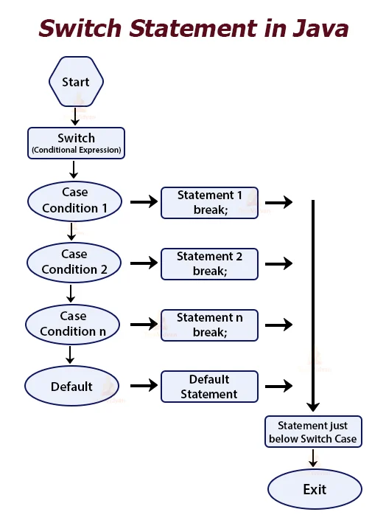
Switch Statement
The switch statement is used for multiway branching based on the value of an expression. It simplifies code when there are multiple possible cases to consider.
switch (expression) {
case value1:
// Code to be executed if expression matches value1
break;
case value2:
// Code to be executed if expression matches value2
break;
// Add more cases as needed
default: // Code to be executed if no case matches the expression
}

Slide 6
Switch example
int dayOfWeek = 3;
String dayName;
switch (dayOfWeek) {
case 1:
dayName = "Sunday";
break;
case 2:
dayName = "Monday";
break;
case 3:
dayName = "Tuesday";
break;
// Add more cases for other days
default:
dayName = "Invalid day";
}
System.out.println("Day of the week: " + dayName);

Slide 7
Example program C style
Below is a Java program that simulates a simple Zoo. We'll use various Java concepts such as data types, variables, operators, conditional statements, for loops, while loops, dowhile loops, and switch.
import java.util.Scanner;
public class ZooProgram {
public static void main(String[] args) {
// Variables
int numberOfAnimals = 0;
boolean isZooOpen = true;
Scanner scanner = new Scanner(System.in);
// Welcome message
System.out.println("Welcome to My Zoo!");
// Main menu
while (isZooOpen) {
System.out.println("\n Main Menu ");
System.out.println("1. Add an Animal");
System.out.println("2. View Number of Animals");
System.out.println("3. Feed the Animals");
System.out.println("4. Exit");
System.out.print("Enter your choice: ");
int choice = scanner.nextInt();
switch (choice) {
case 1:
// Add an animal
numberOfAnimals++;
System.out.println("Animal added to the Zoo!");
break;
case 2:
// View number of animals
System.out.println("Number of Animals in the Zoo: " + numberOfAnimals);
break;
case 3:
// Feed the animals
if (numberOfAnimals > 0) {
System.out.println("Feeding " + numberOfAnimals + " animals...");
System.out.println("Animals are happily fed!");
} else {
System.out.println("No animals in the Zoo to feed!");
}
break;
case 4:
// Exit the program
System.out.println("Goodbye! Thank you for visiting My Zoo!");
isZooOpen = false;
break;
default:
System.out.println("Invalid choice. Please try again.");
break;
}
}
// Close the scanner
scanner.close();
}
}

Slide 8
Explanation:
1. Data Types and Variables:
We use `int` data type to store the number of animals in the zoo (`numberOfAnimals`).
`boolean` data type is used for `isZooOpen`, which controls the loop to keep the zoo open.
2. Operators:
We use the `+` operator to increment the `numberOfAnimals` when adding an animal.
3. Conditional Statements:
We use a `while` loop (`while (isZooOpen)`) to keep the zoo open until the user chooses to exit.
Inside the loop, we use a `switch` statement to handle different user choices.
4. For Loops:
We do not use a for loop in this program.
5. While Loops:
The main loop (`while (isZooOpen)`) is a while loop that keeps the zoo open until the user chooses to exit.
6. DoWhile Loops:
We do not use a dowhile loop in this program.
7. Switch Statement:
We use the switch statement to handle different user choices and execute corresponding actions.
The program allows users to add animals to the zoo, view the number of animals, feed the animals, and exit the zoo.

Slide 9
Zoo program Java OOP style
import java.util.Scanner;
class Zoo {
private int numberOfAnimals;
private boolean isZooOpen;
private Scanner scanner;
public Zoo() {
numberOfAnimals = 0;
isZooOpen = true;
scanner = new Scanner(System.in);
}
public void welcomeMessage() {
System.out.println("Welcome to My Zoo!");
}
public void displayMenu() {
System.out.println("\n Main Menu ");
System.out.println("1. Add an Animal");
System.out.println("2. View Number of Animals");
System.out.println("3. Feed the Animals");
System.out.println("4. Exit");
}
public int getUserChoice() {
System.out.print("Enter your choice: ");
return scanner.nextInt();
}
public void addAnimal(String name) {
numberOfAnimals++;
System.out.println(name + " added to the Zoo!");
}
public void viewNumberOfAnimals() {
System.out.println("Number of Animals in the Zoo: " + numberOfAnimals);
}
public void feedAnimals() {
if (numberOfAnimals > 0) {
System.out.println("Feeding " + numberOfAnimals + " animals...");
System.out.println("Animals are happily fed!");
} else {
System.out.println("No animals in the Zoo to feed!");
}
}
public void closeZoo() {
System.out.println("Goodbye! Thank you for visiting My Zoo!");
isZooOpen = false;
}
public boolean isZooOpen() {
return isZooOpen;
}
public void closeScanner() {
scanner.close();
}
}
import java.util.Scanner;
class Animal {
private String name;
public Animal(String name) {
this.name = name;
}
public String getName() {
return name;
}
}
public class ZooProgram {
public static void main(String[] args) {
Zoo zoo = new Zoo();
zoo.welcomeMessage();
while (zoo.isZooOpen()) {
zoo.displayMenu();
int choice = zoo.getUserChoice();
switch (choice) {
case 1:
System.out.print("Enter the animal name: ");
String animalName = new Scanner(System.in).nextLine();
zoo.addAnimal(animalName);
break;
case 2:
zoo.viewNumberOfAnimals();
break;
case 3:
zoo.feedAnimals();
break;
case 4:
zoo.closeZoo();
break;
default:
System.out.println("Invalid choice. Please try again.");
break;
}
}
zoo.closeScanner();
}
}

Slide 10
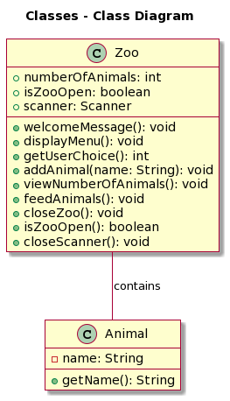
Explanation:
1. We created two classes, `Zoo` and `Animal`, to represent the Zoo and animals, respectively.
2. The `Zoo` class encapsulates the functionality of the zoo, including managing animals and displaying the menu.
3. The `Animal` class represents each animal in the zoo and has a `name` attribute and a getter method for it.
4. The `Zoo` class has methods like `addAnimal`, `viewNumberOfAnimals`, `feedAnimals`, etc., to handle user choices and zoo operations.
5. The main program creates a `Zoo` object and interacts with it using its methods to manage the zoo.
By making the program objectoriented, we promote code organization, encapsulation, and reusability, making it more maintainable and extensible.

Slide 11
Key points
The while loop repeatedly executes a block of code while a condition is true.
The do while loop guarantees at least one execution of the code inside the loop before checking the condition.
The switch statement is used for multiway branching based on the value of an expression.

